Slide 1
The Dorm Den
Arahanta Pokhrel (THA076BCT009)
Bikrant Bidari (THA076BCT013)
Sameer Shrestha (THA076BCT039)
Sudeep Kaucha (THA076BCT044)
Department of Electronics and Computer Engineering
Thapathali Campus
6th January 2023

Slide 2
Overview
Motivation
Objective
Scope Of Project
Proposed Methodology
Expected Outcome
Project Application
Tentative Timeline
Estimated Expenses
References

Slide 3
Motivation
Hostels are generally cheaper than renting a place
Hostels can be more convenient for students
Saves students time and effort in finding a suitable hostel
Hostels often offer additional services and amenities

Slide 4
Objective
To Provide efficient way to find and book hostels
To Provide detailed information about hostel
To offer hostel with reservation management solution

Slide 5
Scope Of Project
Helps students to find and book hostels in various locations.
Reservation and occupancy management solution offered to hostels
Hostel information and comparison feature provided in application

Slide 6
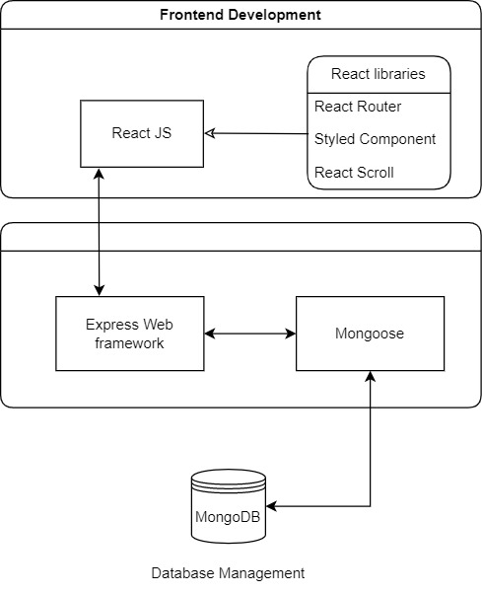
Proposed Methodology –[1]

Slide 7
Proposed Methodology –[2]
MERN stack will be used for the web application.
MongoDB will be used to host the data.
React will be used to present the data in an efficient way.
Express will act as a bridge between the frontend and backend.

Slide 8
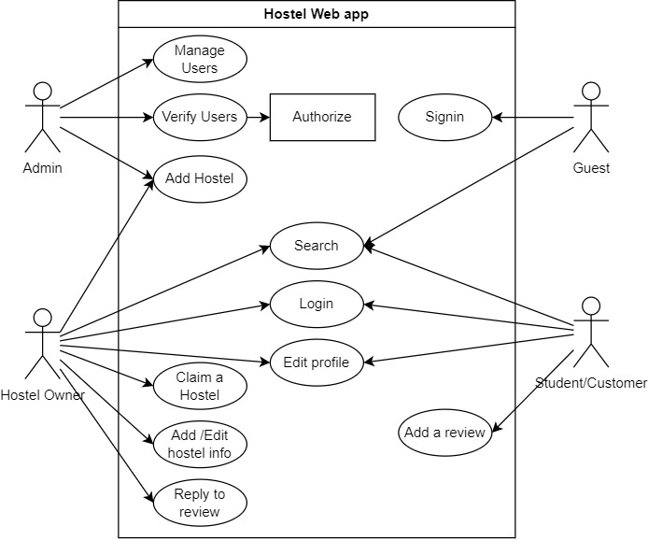
Proposed Methodology –[3]

Slide 9
Proposed Methodology –[4]
Actors : Admins, Guests, Hostel Owners, and Registered Users.
Registered users can search, review, rate hostels
Also use recommendation and suggestion services.
Admins verify documents and moderate content, add hostels.
Hostel Owners can request to add or claim a new hostel .
Guests can only view hostel reviews, not write them

Slide 10
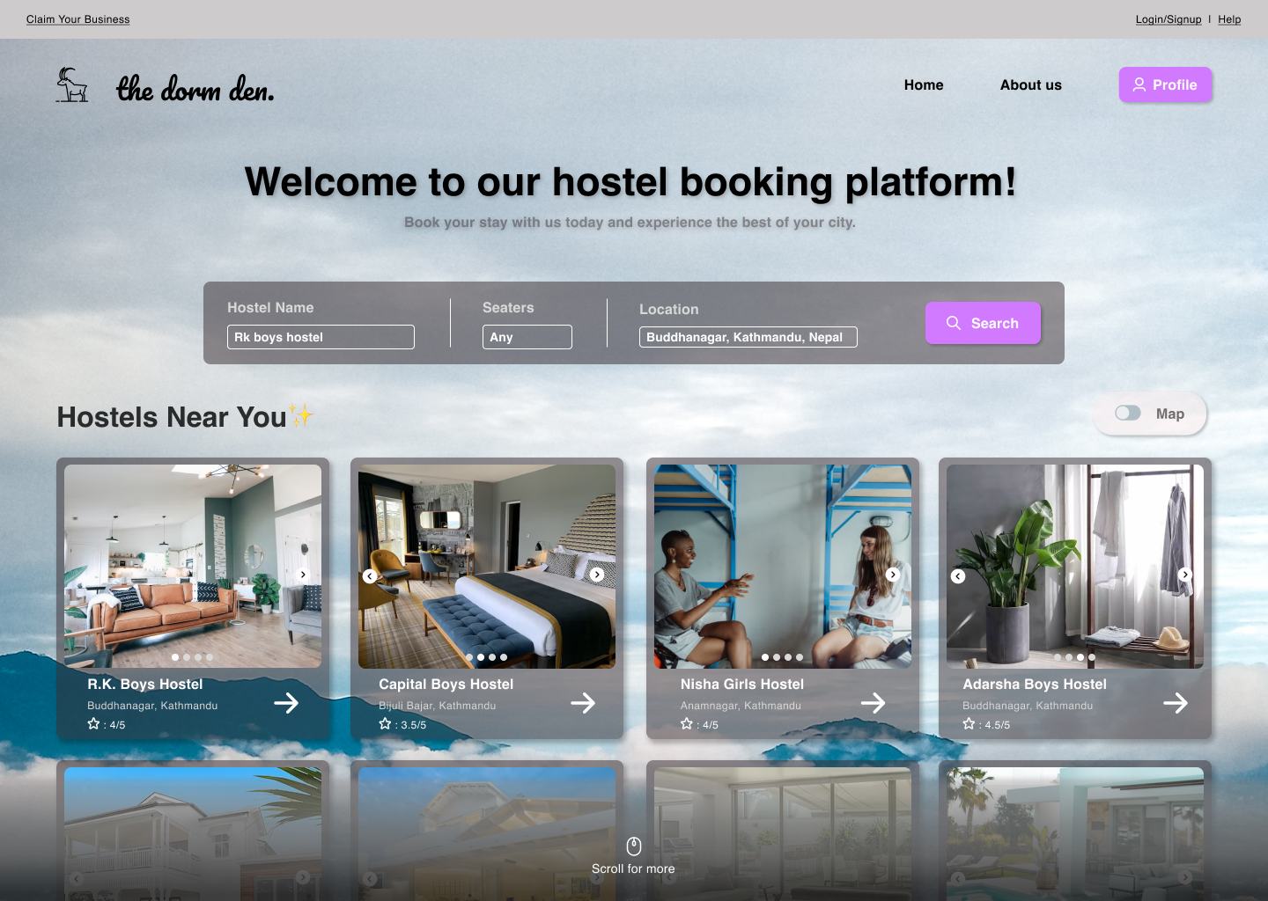
Expected Output –[1]

Slide 11
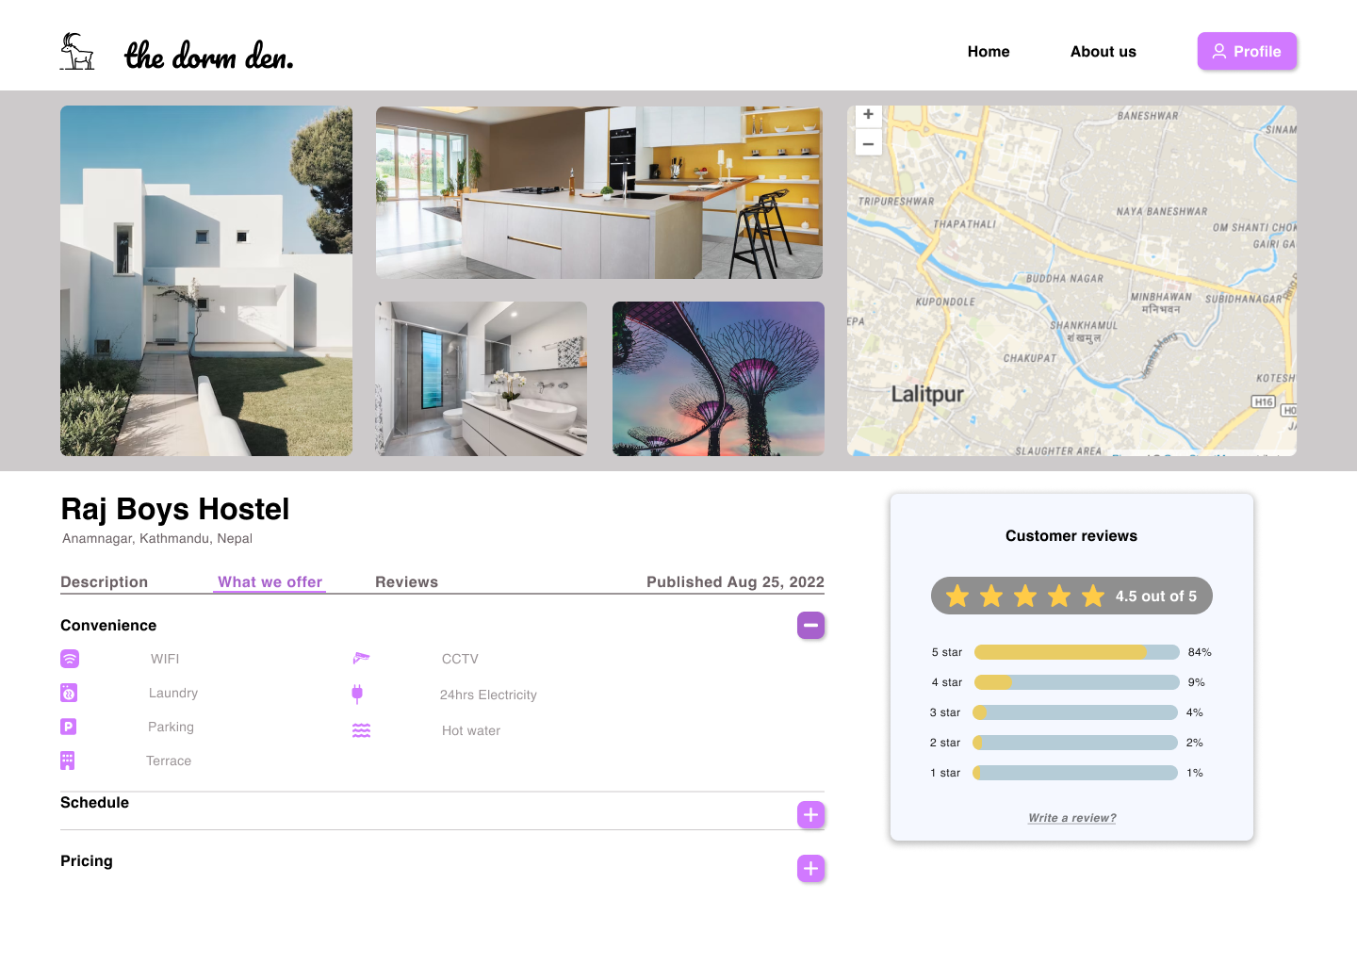
Expected Output –[2]

Slide 12
Project Applications
Comparing prices and amenities
Viewing hostel profile and reviews
Sort out hostels according to preference & location
Time-saving

Slide 13
Tentative Timeline

Slide 14
Estimated Expenses
S.N. | Particulars | Price (Rs) | Quantity | Total Price (Rs)
1. | Server Hosting | 2000 per month | 1 | 2000
2. | Acquiring a domain name | 1500 per year | 1 | 1500
TOTAL |  |  |  | 3500

Slide 15
References –[1]
[1] | "Annual Report," University Grants Commission, 2021.
[2] | S. Chamberlain, H. Sharp and N. Maiden, "Towards a framework for integrating agile development and user-centred design," Extreme Programming and Agile Processes in Software Engineering, vol. 4044, no. 2006, pp. 143-153, 2006.
[3] | J. Ferreria, J. Nole and R. Biddle, "Agil. 2007," in Agile Development Iterations and UI Design, United States, IEEE Computer Society, 2007, pp. 50-58.
[4] | T. Da Silva, A. Martin, F. Maurer and M. Silveria, "User-Centered Design and Agile Methods: A Systematic Review," in AGILE Conference, 2011.

Slide 16
References –[2]
[5] | J. Ferreira, J. Noble and R. Biddle, "Up-front interaction design in agile development," Lecture Notes Computer Science, vol. 4536, no. 2007, pp. 9-16, 2007.
[6] | M. Stonebraker, "SQL databases v. NoSQL," Communications of the ACM, vol. 53, no. 4, pp. 10-11, 2010.
[7] | R. Vatsavai, A. Ganguly, V. Chandola, A. Stefanidis, S. Klasky and S. Shekhar, "Spatiotemporal data mining in the era of big spatial data," in Proceedings of the 1st ACM SIGSPATIAL, California, 2012.
[8] | B. Cheng and X. Guan, "Design and evaluation of a high-concurrency web map tile service framework on a high," International Journal of Grid and Distributed Computing, vol. 9, no. 12, pp. 127-142, 2016.

